Slide 1

Introduction to Business Systems
Toby Abbott – 20102847
Beryl Burns
Notes:
My name is Toby Abbott and this is my introduction to business systems assignment where I will explain my role and my development so far at Barclays. I will be specifically focusing on the evidence I have collected for the 5 key professional skills.

Slide 2

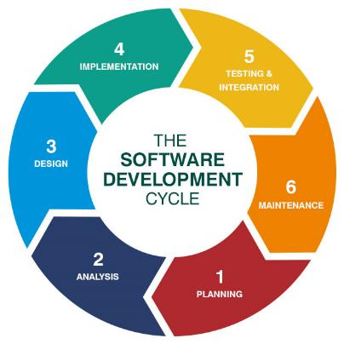
My role at Barclays
Degree Apprentice
Learning to become Technical Delivery Manager
E2E development lifecycle
Currently in testing
Figure 1: What is the software development lifecycle? (Source: Husson University, 2016:online)
Notes:
My role at Barclays, I suppose it’s probably a given, but I am a degree apprentice at MMU, my specific role however is that I am learning to become a Technical delivery Manager. A technical delivery manager is someone who oversees multiple sprint teams and tries to organise and ensure the teams complete their objectives to a deadline. As part of my in-role training I am going through the entire end to end development lifecycle. I am currently working with the testing team, this is stage 5 of this lifecycle. We are currently working on the latest developments for the Barclays online banking systems.

Slide 3
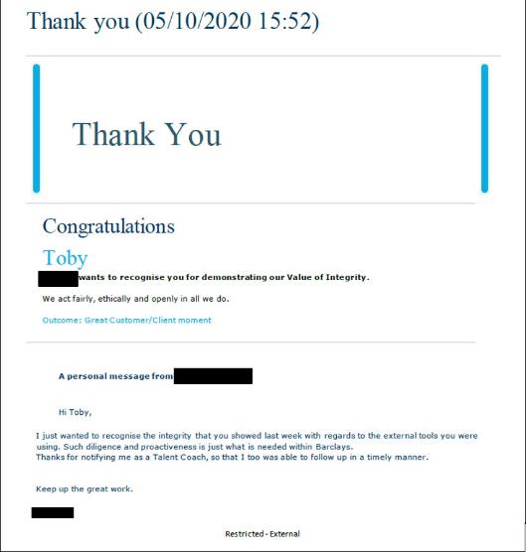
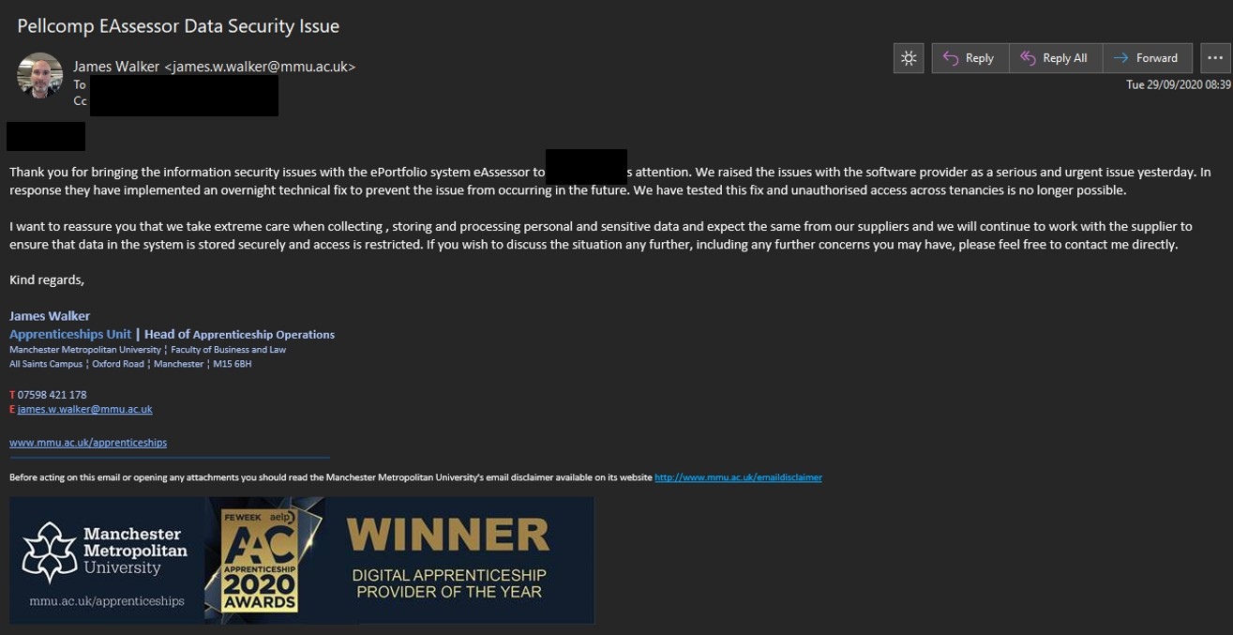
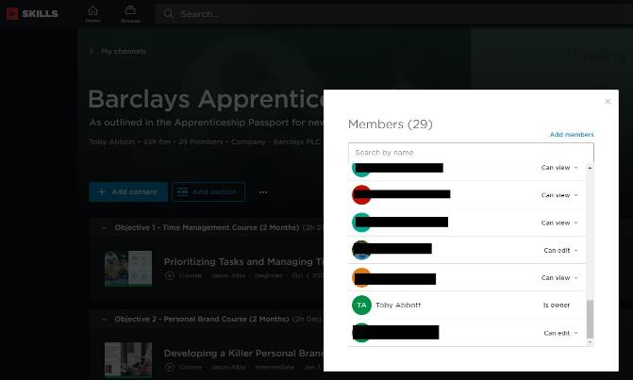
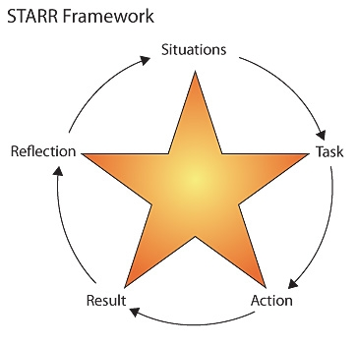
Basic business disciplines, ethics and courtesies
Pellcomp Data Breach
Pluralsight Channel
Figure 2: STARR reflection model (Source: DaphneBakkerBlog, 2016:online)
Notes:
In terms of basic business disciplines, I’m going to use a simplified version of the STARR model in order to discuss my examples, going through situations and the tasks, actions and results associated with those situations
An example of my ethics is when another apprentice and I reported the data breach of the Pellcomp owned system Eassessor,
The situation was that we had discovered a fault in the system that allowed us to access personal information of other users
Task – we assigned ourselves the task of raising this issue and following it through until it was fixed
The action we took was speaking to and emailing the MMU employee who was the bridge between MMU and Pellcomp and we followed it through as it got raised to his boss, and as it was reported to Pellcomp
The result was that the breach has been prevented from occurring again, and the university is giving Pellcomp less data in future.
this is evidenced by the formal recognition I received from my career coach at Barclays and the informal recognition, the other apprentice and I received from James Walker, the head of apprenticeship operations at MMU.
For courtesy, I recently created a Pluralsight channel to help the other apprentices and myself, it was a way of collating all the mandatory training for our induction and other useful training courses, this made it easier for myself and the other apprentices to complete our training very quickly despite the extra difficulty of remote working.

Slide 4
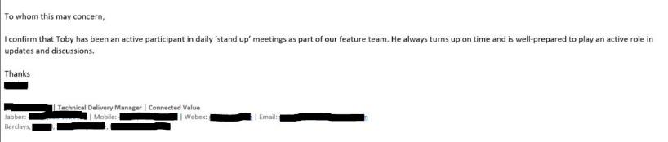
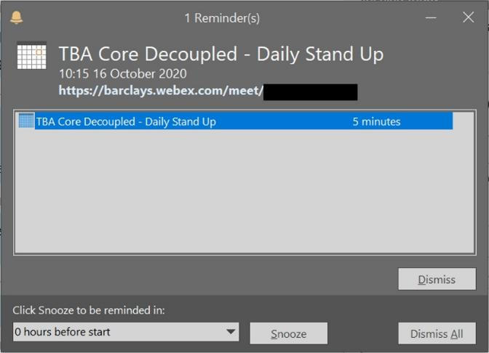
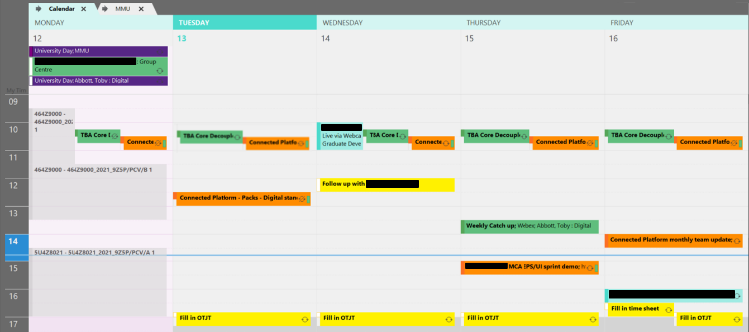
Timeliness, focus and ability to complete tasks to a deadline
Daily Stand-ups
125 test cases
Notes:
For the timeliness, focus and ability to complete tasks to a deadline part of this KSB I have the following examples:
Situation – I join stand-ups everyday for both teams that I work with, as you can see on my calendar, the stand up meetings are circled in red
Task – I need to join the meetings on time and focus entirely on the meeting at the time
Action – I set reminders for every meeting and minimise all other distractions from my screen
Result – I have been able to attend on time and retain full focus for all daily stand-ups that I am available for
This is evidence by the screenshots I have shown and a witness statement from my line manager
A situation that shows my ability to complete tasks to a deadline with high quality is when one of the teams I am working with had 125 test cases that needed to be completed within 5 days. We decided to split the cases between the team and managed to successfully complete all the cases in just 3 days. This cannot be evidence because the deadline for this project has been and gone so there is no data for those cases that we completed. However in a later slide, I will show you data for the current sprint we are working on.

Slide 5
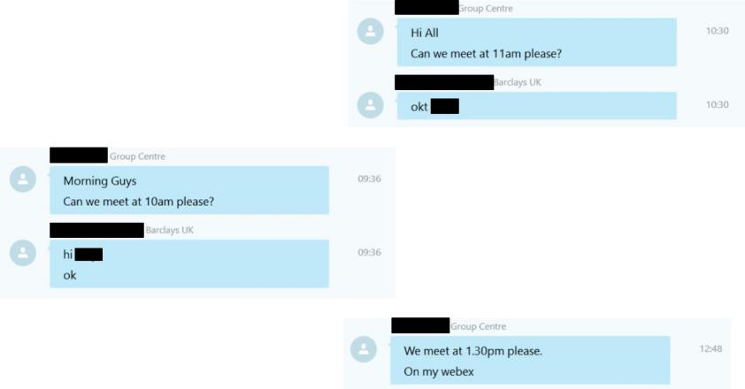
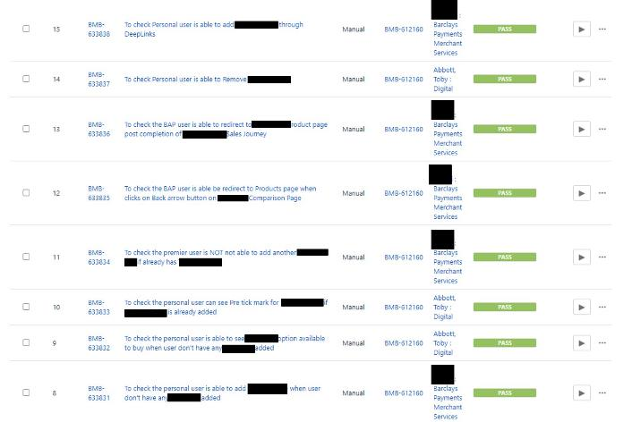
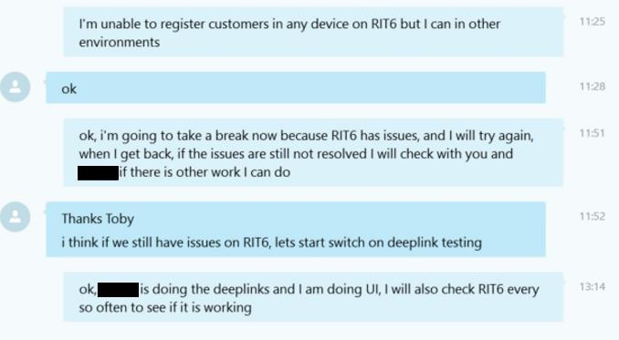
Flexible attitude
Working with a team largely based in India, have to be flexible with meetings to be able to rearrange and fit their time zone
I am currently working as a resource for the testing team
3
3
Notes:
A flexible attitude, most of my day is spent working with two teams who are based in India, this means rearranging meetings to fit with their time zone. It also means I have to work a lot more with impromptu meetings. As shown in my calendar earlier I don’t have a huge number of scheduled meetings everyday, but as shown in these few example messages I have a lot more meetings during the day than shown in my calendar. This means I have to be flexible and able to adjust what I am doing to fit around their schedules. My colleagues in the two teams are much more experienced in their work so I am happy to work around their much busier schedules.
As part of my in role training I am a resource for the testing team, meaning that I need to be flexible and able to change my focus onto whatever I am told is the priority for me to work on. Meaning I pick up the cases that others, for whatever reason, can’t complete, you can see an example of this from the seemingly random assignment of cases to me in this test execution set.
Another part of working in the testing team is being flexible with when I assign time to different projects and when to take my break, as you can see in this message chain, I took my break earlier than I normally would because there was some down time in the testing environment, so rather than waste time while that happened I took my break then instead, giving a chance for the issue to be resolved.

Slide 6
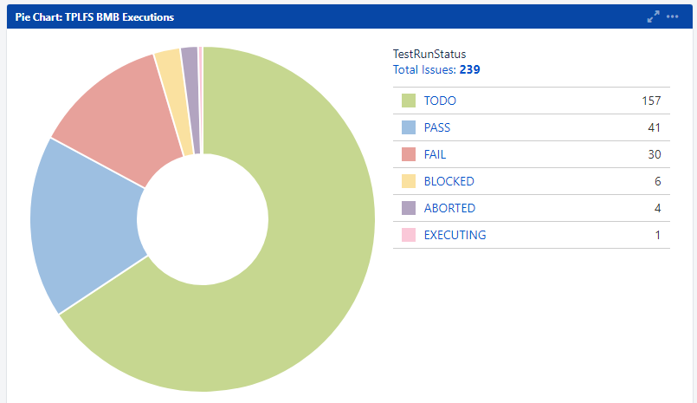
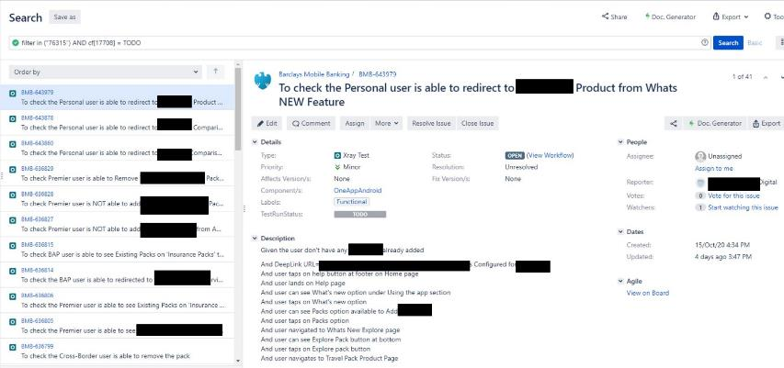
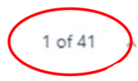
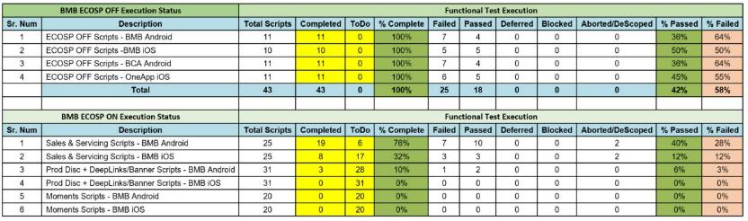
Performing Under Pressure
125 cases within 5 days, is pressure because it is a deadline that must be met
Notes:
For performing under pressure I want to refer back to a situation I referenced earlier, where one of the teams I am working with had 125 test cases to complete within 5 days. I don’t have the old chart showing the tests for this deadline as it has already passed, instead I have added a chart showing the test cases for the current sprint as an example of the number of cases we as a team need to complete within a sprint cycle. This is a perfect example of performing under pressure as it is very rare that the team is unable to meet the deadlines we are given. To add to this pressure often cases need to be tested multiple times, if the case fails then it needs to be fixed and retested, all before the deadline.
Another way to visualise this is to show you a list of cases I was asked to assist one of the members in the team to complete, you might be able to see in the top right of this image there are 41 cases in this set that the two of us were asked to complete alongside our other work by the end of the week. It was difficult but because we communicated well and split the cases sensibly we were able to do it.
Here is also an excel table that the team filled out and returned to the project leader, detailing the results we had found for 195 tests which we worked on to complete ready for a build release.

Slide 7

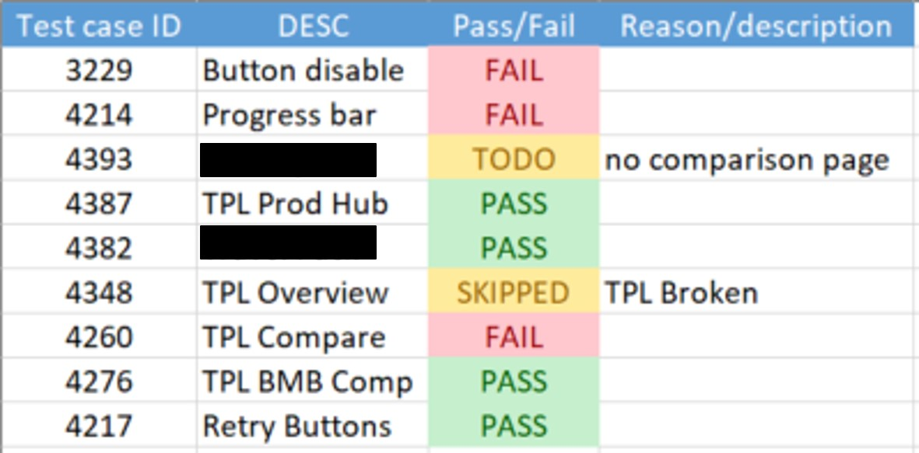
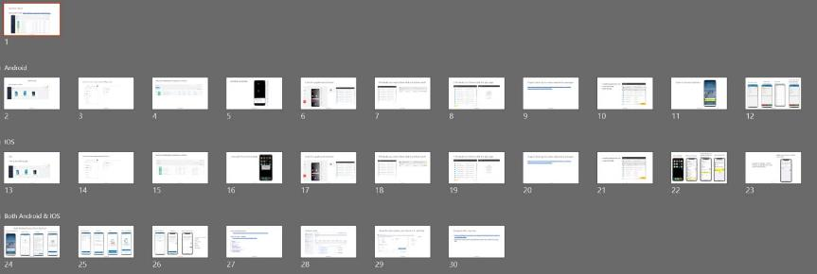
A Thorough Approach to Work
Spreadsheets of test cases to ensure done correctly
Notes to ensure I know the process
Going through cases one by one
Notes:
To ensure I have been working to the highest standard I can, I have created spreadsheets and I have been very thorough in recording the work I have done in a clear way so I can easily check and identify if I make any mistakes. Another way in which I have been thorough in my approach to work is by creating extensive notes and PowerPoints that clearly state how the process works. I have designed these notes in such a way that they can also be used by other employees who need to learn how the team works. I also take a systematic approach to my work, going through all the cases we need to complete one by one, not moving on to the next task until I have fully completed the first.

Slide 8
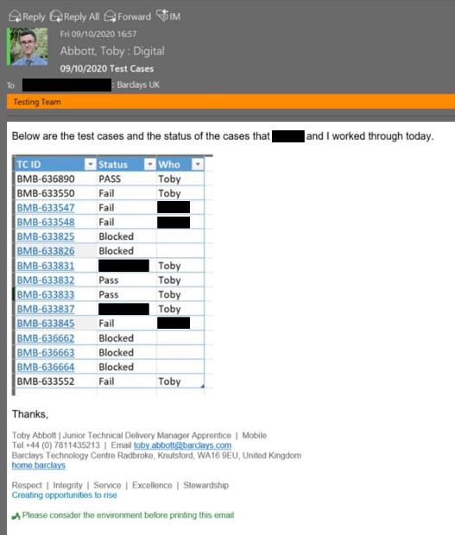
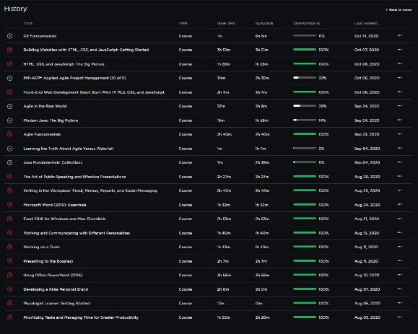
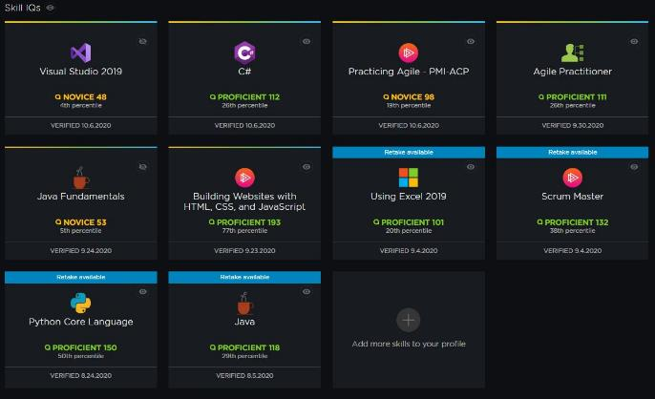
A Thorough Approach to Work
End of day report
Wider reading
Pushing/testing myself
Notes:
At the end of everyday I send a report of the work I have completed to the test team lead so that he can report back to the project lead and they can work out what needs to be worked on next as a priority, in this I spend a little bit of my time at the end of the day cutting down the information I have gathered in my spreadsheet, so that I am only sending the information the test lead needs to be able to do their job.
Another way I am thorough in my work is the wider “reading” I do in my downtime when I am blocked. I have spent many hours on pluralsight developing my knowledge of subject areas that are very useful for my job role and university course.
Pluralsight also include small tests called skill IQs, these are a great way to asses how you are progressing in different subject areas, and I have spent some time completing these tests in subject that are relevant to my job role and university course, pushing myself to further my knowledge.

Slide 9
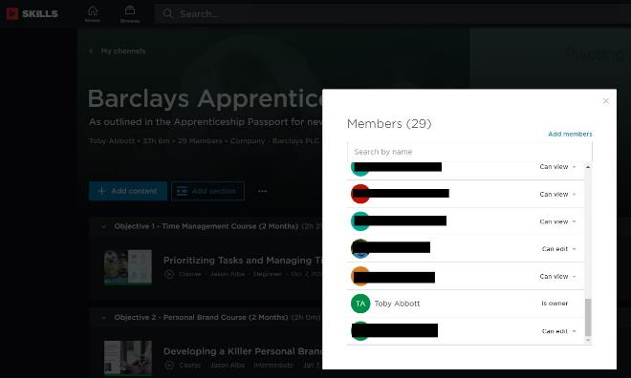
Logical and Creative Problem Solving
Working from home
Internet Connectivity Issues
Error in testing process
Logical stepping through process
Found and resolved issue
Pluralsight channel
Notes:
Logical and Creative problem solving is a difficult one to evidence as the job role I’m working in currently is very structured and has specific instructions and rule. One example however is outside of my job role, working from home has been a challenge that we have all had to work around. And that combined with both my parents working from home as well has required some creativity in terms of internet and time management . Specifically in my job role however there have been plenty of scenarios where the specific instructions have not worked for any given reason and it has required logical problem solving to work through the steps and find and fix the issue. One specific example is when I was testing a scenario in IOS and the instructions for setting up the device were unclear and not working, at this point I had to go through every step individually and try other options until I found and fixed the issue. I also want to refer back to an example I used earlier, where I created a pluralsight channel to help the apprentices with their mandatory training. The problem was we had one pdf saying the courses we needed to complete and search for ourselves, so I collated them together online to make it easier for all us.

Slide 10
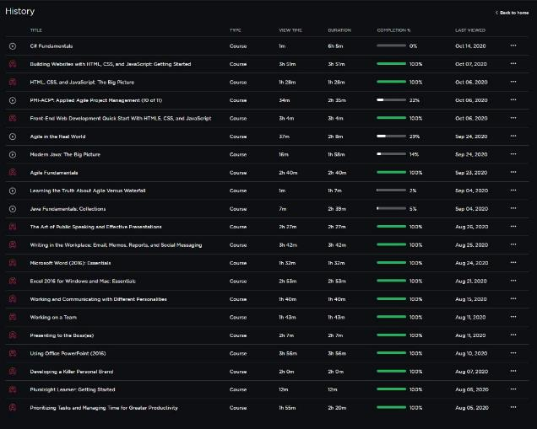
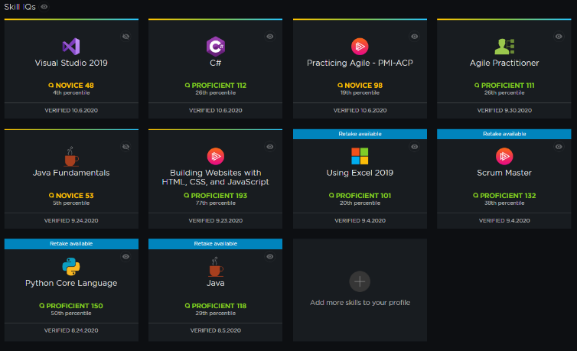
Off the Job Training
University Lectures
Many hours on Pluralsight
34Hrs 59 Minutes 20/10/2020
Skill IQs
Notes:
Part of the off the job training is the one day a week during term time that I spend on teams calls for University lectures, and the time I spend during the working day on assignments for my university modules. Another big part of my off the job training is the many hours I spend on pluralsight developing my knowledge. As of the 20th of October I have spent nearly 40 hours watching pluralsight courses on a range of topics, from Using Powerpoint and working on a team to Java and web development. Another part of my time off the job is spent completing something called skill IQs on Pluralsight, this lets me asses my knowledge of different subject areas and I can see how I am progressing over time. It is useful as another way to assess my progress in the university modules.

Slide 11
Professional Development - STARR
Situation – Working from home.
Task – Find a way to be able to be proactive and motivated
Activities – Arrange social events with colleagues.
Results – Felt more comfortable colleagues.
Reflection – Difficulty multiplied by being isolated.
Notes:
My Professional development so far, well one major development is to do with working from home, I needed to find a way to motivate myself to continue working when there is no one to enforce it, and to be proactive in interacting with colleagues when I need help. One thing I did was I tried to arrange social activities and events with my colleagues to replace the face to face interaction you would have in an office, this made work more enjoyable because it felt like I was working with friends with helped my motivation, and it also meant I felt more comfortable asking colleagues for help. Looking back I think the motivation and interaction with colleagues was hugely hindered by the isolation of lockdown, but I think my solutions have really helped me and hopefully the other apprentices too.

Slide 12
Professional Development - STARR
Situation – Work Meetings.
Task – Be proactive and engage.
Activities – Completed Pluralsight courses.
Results – Knew how to engage.
Reflection – Used old and new knowledge.
Notes:
Another way that I have developed professionally is within meetings. I need to engage, ask questions, answer questions and generally get involved in work meetings. To do this I completed some courses on pluralsight about working in a team and communicating with your bosses. This meant I was able to get involved in work meetings. I felt I was actually contributing at work. And I was able to use my old and knew knowledge from drama at school and the pluralsight courses I had taken to improve my professionalism within meetings.

